Slide 1


Everything
Country
Maverick 102.3 Lineup
Maverick 102.3 — delivering a sense of community to the Roanoke Valley, Lake Country, and Southside Virginia.
THE ROANOKE VALLEY'S COUNTRY LISTENERS LOVE
THE FORMAT AND STAY CONNECTED ABOUT COMMUNITY EVENTS.
All your country
favorites —
all the time.
Mon-Fri 6a-9a
The Maverick Talk Show with
Allen Garrett
74%
66%
45%
Homeowner
Employed
White collar
31%
57%
36%
One+ children (<18)
Some college+
Earn $100,000+
16%
14%
Mon-Fri 9a-1p
Allen Garrett
Gender Breakdown
Plan to perform a home improvement in the next year
Plan to purchase or lease a vehicle in the next year
THE COUNTRY FORMAT FOR THE ROANOKE VALLEY
DELIVERS A MULTI-GENERATIONAL AUDIENCE.
Mon-Fri 1p-7p
David Perkins
18-24
25-34
35-44
45-54
55-64
65+
RALEIGH-DURHAM (FAYETTEVILLE), NC; 2024 Spring MRI-Simmons Market-by-Market; A18+; Country format.
INSIGHTS BY
FuturiTopLine.com
Copyright © 2024 Futuri Media LLC, TOPLINE. All Rights Reserved

Slide 2


Profile of the Local Country Listener
Country radio delivers a key demographic.
52%
are aged 25-54.
59%
are married.
Country
listeners spend
4 hours
and
49 minutes
a day with
music!*
56%
are female.
67%
are pet owners.
38%
have a child at home.
Country listeners are hardworking homeowners.
62%
are employed.
75%
are homeowners.
54%
have some college education.
44%
more likely than
the national average to drive a truck.
41%
have an annual household income of $100,000+.
U.S.; 2024 Spring MRI-Simmons Market-by-Market; A18+; Country format; % of Target; Target Index vs. National Average of 100; | *http://www.insideradio.com/free/country-music-fans-tune-in-longer-digging-am-fm/article_eff34ce6-229b-11e8-af81-8788ad63d375.html.
INSIGHTS BY
FuturiTopLine.com
Copyright © 2024 Futuri Media LLC, TOPLINE. All Rights Reserved

Slide 3


























Why Byrne Digital?
DATA DRIVEN SOLUTIONS
01
Audience First Targeting
Programmatic
Video
Website
Retargeting
Category
Contextual
Addressable
Geo-Fencing
PROGRAMMATIC PLATFORM
Keyword
Contextual
Campaign Management
02
Premium Inventory Placement
Geo-Fencing
UNSTRUCTURED, ELEMENTAL DATA
Behavioral
Targeting
Event Targeting
Audience
Expansion,
Optimization &
Understanding
Reporting &
Analytics
Facebook
03
Experienced Hands-On Partner
Native
Programmatic
Waze
Call Rail
Keyword Search
Retargeting
Look-a-like
Targeting
04
Performance-Driven Measurable Results
OTT/CTV
CRM
Targeting
SEO
SEM

Slide 4
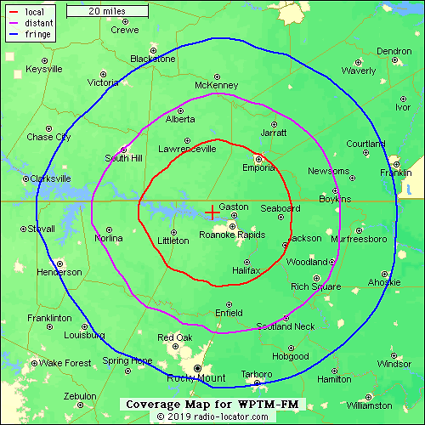
WPTM-Maverick 102.3
The Roanoke Valley’s Country Station
Maverick 102.3
Voice Of The Roanoke Valley with
The Maverick Morning Talk Show with Allen Garrett
Roanoke Rapids High School Sports LIVE
Commitment to community

