Slide 1

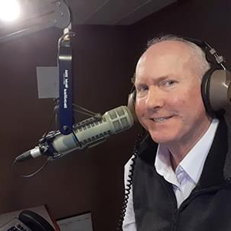
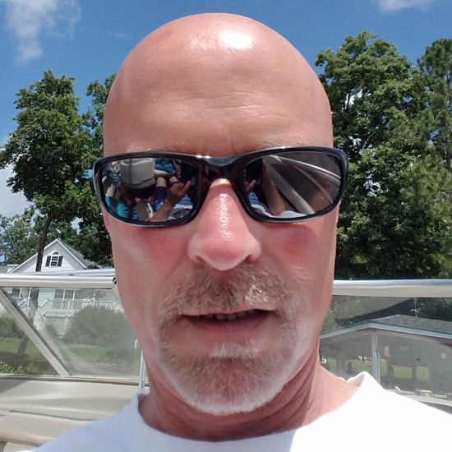


We Play Your Favorite Songs
Gender Breakdown
50%
FEMALE
Your at-work station
50%
Your ‘80s based Classic Hits station, delivering adults who spend their leisure time on the lake in North Carolina and Southside Virginia.
MALE
Delivering an active audience.
107.7 The Lake Lineup
77%
84%
The Anna & Raven Show Mornings
Mon-Sat 5a-10a
6%
Homeowner
Active on social platforms
18-24
9%
59%
27%
25-34
32%
65+
13%
Allen Garrett Middays
Mon-Fri 10a-3p
Employed
More likely to sell their home in the next year
35-44
40%
Earn $100,000+
16%
27%
18%
David Perkins Afternoons
Mon-Fri 3p-7p
Plan to invest in stocks or bonds in the next year
55-64
45-54
51%
Some College +
16%
Our Classic Hits format delivers
Gen X and Baby Boomers in the age
of upgrades and acquisition.
White Motors
Friday Beach Blast
with Andy Lucy Friday Afternoons
5p-9p
38%
Plan to purchase or lease a vehicle in the next year
White collar
2024 Spring MRI-Simmons Market-by-Market; A18+; Classic Hits format;
INSIGHTS BY
FuturiTopLine.com
Copyright © 2024 Futuri Media LLC, TOPLINE. All Rights Reserved

Slide 2


Profile of the Classic Hits Listener.
Profile Information for Classic Hits Listeners
48%
are male.
52%
are female.
75%
own their home.
60%
are employed.
54%
have an annual household income of $75,000+.
51%
say that listening
to radio is relaxing.
53%
of them affirm that the radio puts them in a good mood.
Target Age Composition
CLASSIC HITS LISTENERS ARE PLANNING TO SPEND
FOR A VARIETY OF ITEMS IN THE NEXT 12 MONTHS.
32%
plan to travel abroad.
33%
plan to purchase or lease a vehicle in the next year.
67%
plan to travel in the U.S.
12%
plan to change their job in the next 12 months.
2024 Spring MRI-Simmons USA; A18+; Classic Hits Format; % of Target.
INSIGHTS BY
FuturiTopLine.com
Copyright © 2024 Futuri Media LLC, TOPLINE. All Rights Reserved

Slide 3


























Why Byrne Digital?
DATA DRIVEN SOLUTIONS
01
Audience First Targeting
Programmatic
Video
Website
Retargeting
Category
Contextual
Addressable
Geo-Fencing
PROGRAMMATIC PLATFORM
Keyword
Contextual
Campaign Management
02
Premium Inventory Placement
Geo-Fencing
UNSTRUCTURED, ELEMENTAL DATA
Behavioral
Targeting
Event Targeting
Audience
Expansion,
Optimization &
Understanding
Reporting &
Analytics
Facebook
03
Experienced Hands-On Partner
Native
Programmatic
Waze
Call Rail
Keyword Search
Retargeting
Look-a-like
Targeting
04
Performance-Driven Measurable Results
OTT/CTV
CRM
Targeting
SEO
SEM

Slide 4
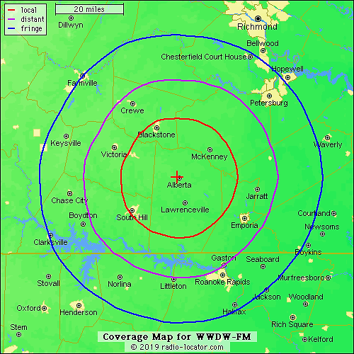
WWDW-107.7 The Lake
We Play Your Favorite Classic Hits
107.7 The Lake
Anna and Raven in the Morning
Virginia Network News each hour
Friday Night Beach Blast with Andy Lucy
Shaggin’ on the Beach with Jay Jenkins
1077LakeFM.com

