Slide 1

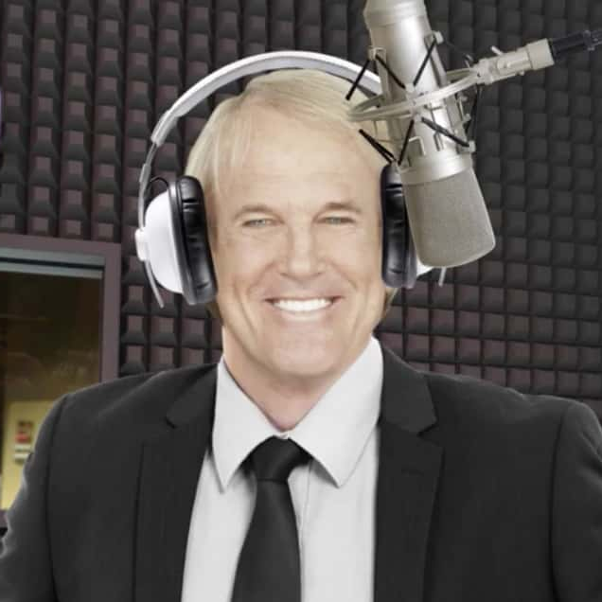
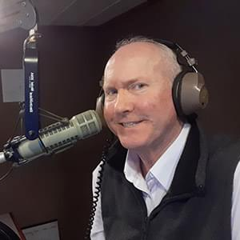
The Greatest Hits of All Time!
Magic 97.9 is your at-work listening station.
Your message will be
sure to resonate with Raleigh’s Classic Hits audience
who has disposable income.
Magic 97.9 Lineup
Mon-Fri 5a-10a The Anna and Raven Show
49%
FEMALE
Mon-Fri 10a-3p John Tesh Intelligence For Your Life
79%
Homeowner
58%
Employed
29%
Bachelor’s degree+
51%
MALE
47%
White collar
56%
Earn $75,000+
43%
Earn $100,000+
Mon-Fri 3p-8p
Allen Garrett
Special Weekend Programming:
73%
More likely to purchase a 2-door vehicle in the next year
22%
One+ children (<18)
White Motors Friday Beach Blast with Andy Lucy
Friday 5p-9p
Shaggin' On The Beach With Jay Jenkins Sunday Afternoon 2p-7p
Casey Kasem’s American
Top 40-The 80’s Saturday 8a-12p
Casey Kasem’s American Top 40-The 70’s Sunday 9a-12p
Age Breakdown
RALEIGH-DURHAM (FAYETTEVILLE, NC); 2024 Spring GfK MRI Market-by-Market; DMA; A18+; Classic Hits format;
INSIGHTS BY
FuturiTopLine.com
Copyright © 2024 Futuri Media LLC, TOPLINE. All Rights Reserved

Slide 2







Profile of the Classic Hits Listener
48%
male
52%
female
75%
own their home
60%
are employed
54%
have an annual household income of $75,000+.
51%
53%
say that listening to
the radio is relaxing
of them affirm that the radio puts them in a good mood.
TARGET AGE COMPOSITION
Classic Hits listeners are planning to spend on a variety of items in the next 12 months.
32%
plan to travel abroad
33%
plan to purchase or lease a vehicle in the next year
67%
plan to travel in the U.S.
12%
plan to change their job in the next 12 months
2024 Spring MRI-Simmons USA; A18+; Classic Hits format; % of Target.
INSIGHTS BY
FuturiTopLine.com
Copyright © 2024 Futuri Media LLC, TOPLINE. All Rights Reserved

Slide 3

























Why Byrne Digital?
DATA DRIVEN SOLUTIONS
01
Audience First Targeting
Programmatic
Video
Website
Retargeting
Category
Contextual
Addressable
Geo-Fencing
PROGRAMMATIC PLATFORM
Keyword
Contextual
Campaign Management
02
Premium Inventory Placement
Geo-Fencing
UNSTRUCTURED, ELEMENTAL DATA
Behavioral
Targeting
Event Targeting
Audience
Expansion,
Optimization &
Understanding
Reporting &
Analytics
Facebook
03
Experienced Hands-On Partner
Native
Programmatic
Waze
Call Rail
Keyword Search
Retargeting
Look-a-like
Targeting
04
Performance-Driven Measurable Results
OTT/CTV
CRM
Targeting
SEO
SEM

Slide 4
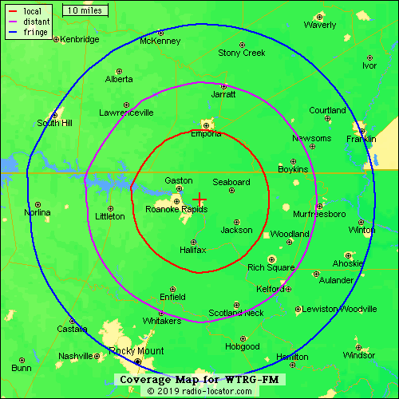
WTRG – Magic 97.9
The Roanoke Valley’s Classic Hits Station
Magic 97.9
The Anna And Raven Morning Show
John Tesh Intelligence For Your Life
Friday Beach Blast With Andy Lucy and Shaggin’ On The Beach with Jay Jenkins
Magic979WTRG.com

