Slide 1
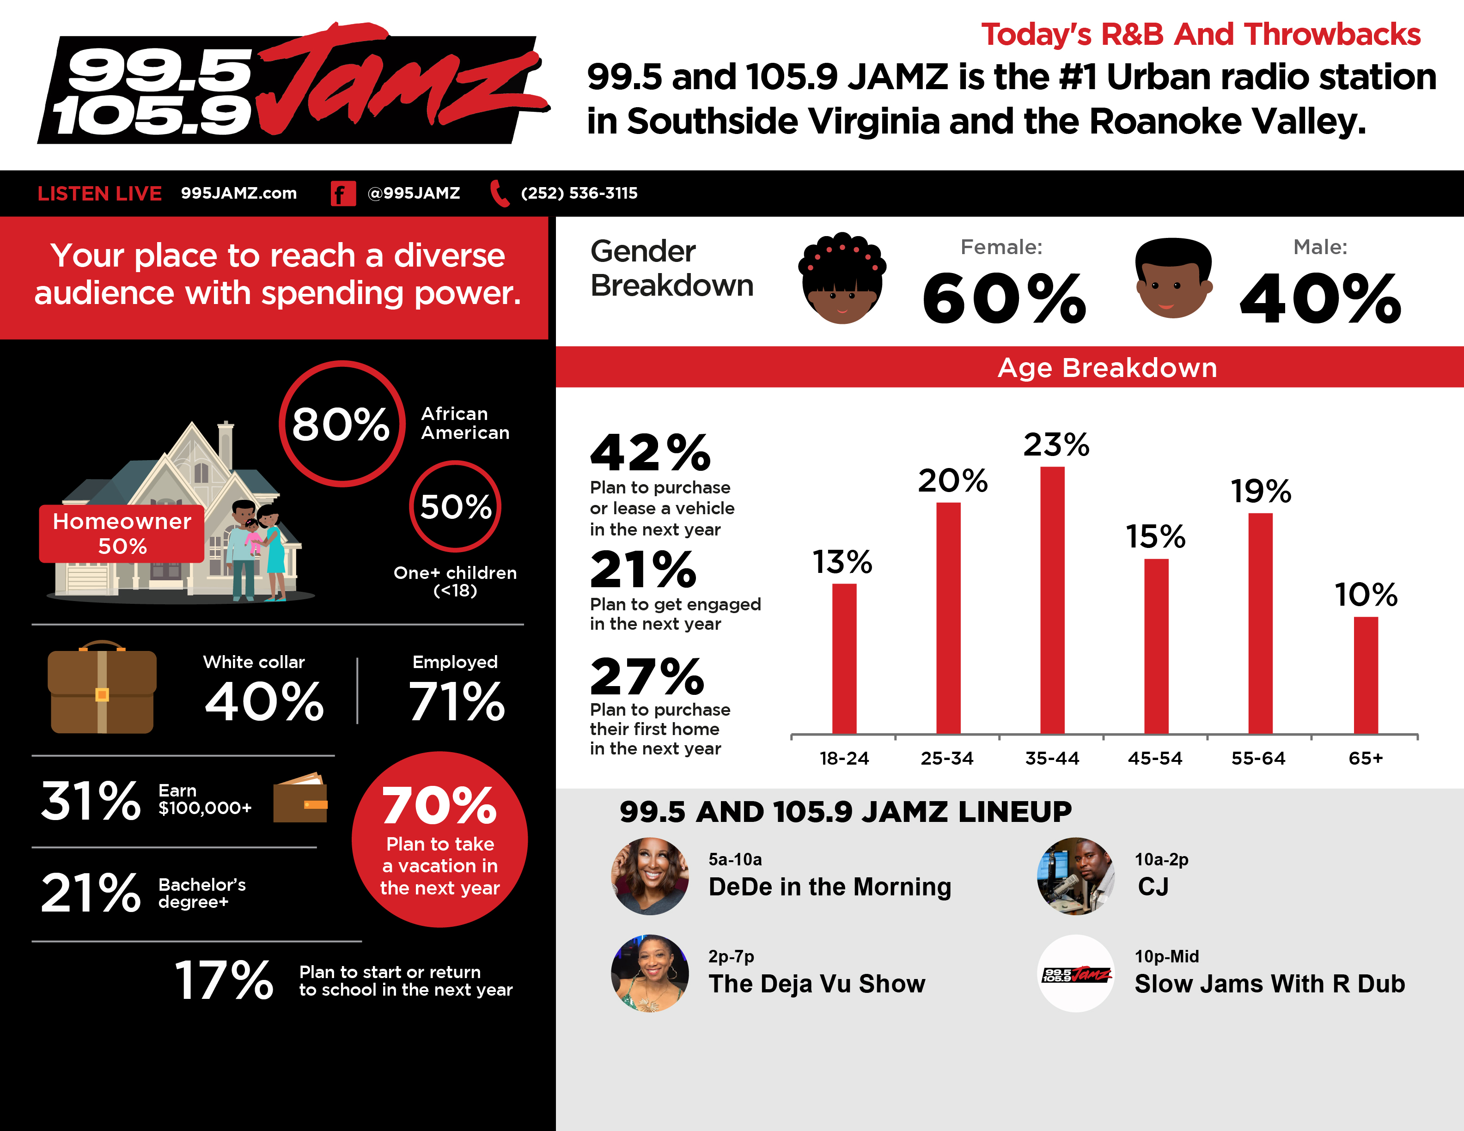
RICHMOND-PETERSBURG, VA; 2023 Fall MRI-Simmons Market-by-Market; A18+; Urban format; % of Target.
INSIGHTS BY
FuturiTopLine.com
Copyright © 2024 Futuri Media LLC, TOPLINE. All Rights Reserved

Slide 2







Profile of the Urban Listener
Profile information for urban listeners:
Target Age Composition
43% are male.
% of Target
57% are female.
46% own their home.
66% are employed.
66% have an annual household income of less than $100,000.
44% say that listening to the radio is relaxing.
46% of them affirm that the radio puts them in a good mood.
Urban listeners are planning to spend on a variety of items in the next 12 months.
37%
55%
67%
72%
2x
plan to purchase or lease a vehicle in the next year.
more likely than the U.S. average to plan to purchase a home.
plan to travel within
the U.S.
more likely to plan on starting or going back to school.
more likely to start or buy a new business.
2024 Spring MRI-Simmons USA; A18+; Urban format; % of Target; Target Index vs. National Average of 100.
INSIGHTS BY
FuturiTopLine.com
Copyright © 2024 Futuri Media LLC, TOPLINE. All Rights Reserved

Slide 3


























Why Byrne Digital?
DATA DRIVEN SOLUTIONS
01
Audience First Targeting
Programmatic
Video
Website
Retargeting
Category
Contextual
Addressable
Geo-Fencing
PROGRAMMATIC PLATFORM
Keyword
Contextual
Campaign Management
02
Premium Inventory Placement
Geo-Fencing
UNSTRUCTURED, ELEMENTAL DATA
Behavioral
Targeting
Event Targeting
Audience
Expansion,
Optimization &
Understanding
Reporting &
Analytics
Facebook
03
Experienced Hands-On Partner
Native
Programmatic
Waze
Call Rail
Keyword Search
Retargeting
Look-a-like
Targeting
04
Performance-Driven Measurable Results
OTT/CTV
CRM
Targeting
SEO
SEM

Slide 4
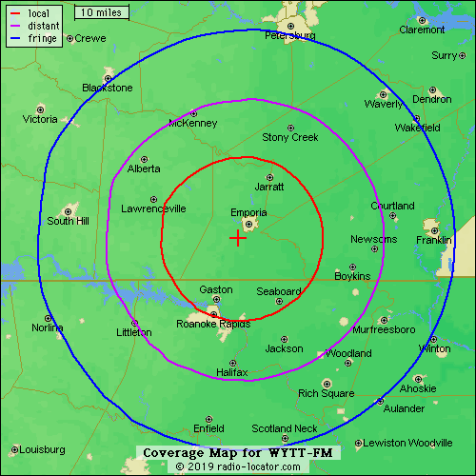
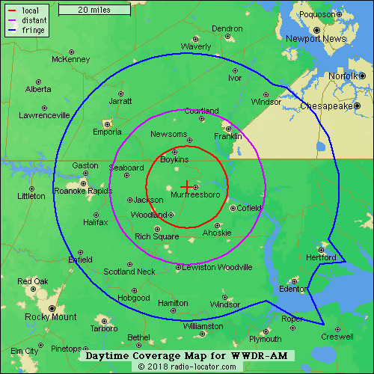
WYTT-99.5 and 105.9 Jamz
The Vibe of NC and VA
99.5-105.9 Jamz

