Slide 1
Local to Murfreesboro, Ahoskie and Franklin provides a mix of the ‘70s, ‘80s, ‘90s, 2000s, current hits and classic hits to Northeastern North Carolina and Southside Virginia.
49%
51%
FEMALE
MALE
Delivering affluent adults in the age of upgrades.
10%
19%
18-24
65+
13%
25-34
71%
71%
45%
32%
23%
26%
15%
28%
Employed
Homeowner
White collar
One+ children
(<18)
Bachelor’s
degree+
Earn
$100,000+
55-64
35-44
15%
97%
26%
45-54
More likely than the market average to buy a major appliance in the next year
Plan to purchase a
vehicle in the next year
Earl 98.3 Lineup | SPECIAL PROGRAMMING INCLUDES
THE JAY JENKINS MORNING SHOW MON-FRI 6A-9A | CHOWAN COLLEGE COACHES CORNER THURSDAY 7P-8P
WHITE MOTORS FRIDAY BEACH BLAST WITH ANDY LUCY FRIDAY 5P-9P | SHAGGIN' ON THE BEACH WITH JAY JENKINS SUNDAY 2P-7P
NORFOLK-PORTSMOUTH-NEWPORT NEWS, VA; 2024 Spring MRI-Simmons Market-by-Market; A18+; Adult Hits format; Target Persons %; Target Index vs. Market Average of 100.
INSIGHTS BY
FuturiTopLine.com
Copyright © 2024 Futuri Media LLC, TOPLINE. All Rights Reserved

Slide 2









Profile of the Adult Hits Listener
Adult Hits listeners are professional men with families.
66% are employed.
53% are men.
53% are between the ages of 25-54.
44% have an annual household income of $100,000+.
38% have one or more children under age 18.
55% are married.
68% are homeowners.
Adult Hits listeners are likely to be planning big changes and purchases in the next 12 months.
20%
are likely to buy a home.
30%
plan to purchase or lease a vehicle.
65%
more likely than the national average to be planning for a child to go away to college.
62%
intend to take a trip in the U.S.
20%
plan to purchase large household furnishings.
65%
more likely to plan to refinance their mortgages.
2024 Spring MRI-Simmons USA; A18+; Adult Hits format; % of Target; Target Index vs. National Average of 100.
INSIGHTS BY
FuturiTopLine.com
Copyright © 2024 Futuri Media LLC, TOPLINE. All Rights Reserved

Slide 3


























Why Byrne Digital?
`
DATA DRIVEN SOLUTIONS
01
Audience First Targeting
Programmatic
Video
Website
Retargeting
Category
Contextual
Addressable
Geo-Fencing
PROGRAMMATIC PLATFORM
Keyword
Contextual
Campaign Management
02
Premium Inventory Placement
Geo-Fencing
UNSTRUCTURED, ELEMENTAL DATA
Behavioral
Targeting
Event Targeting
Audience
Expansion,
Optimization &
Understanding
Reporting &
Analytics
Facebook
03
Experienced Hands-On Partner
Native
Programmatic
Waze
Call Rail
Keyword Search
Retargeting
Look-a-like
Targeting
04
Performance-Driven Measurable Results
OTT/CTV
CRM
Targeting
SEO
SEM

Slide 4
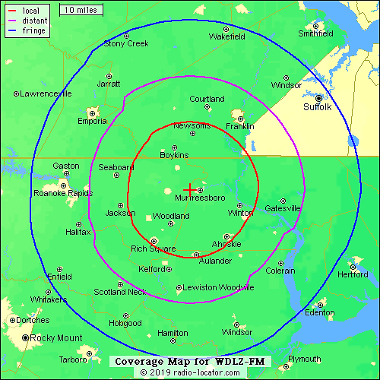
WDLZ-Earl 98.3
Murfreesboro, Franklin, and Ahoskie Classic Hits
Earl 98.3
Jay Jenkins Morning Show
Chowan University Sports Talk
Jay Jenkins - Shaggin’ on the Beach and
Friday Night Beach Blast with Andy Lucy

